Slide 1
Credit Default Analysis
Project Process and Initial Data Analysis/Recommendations
Kevin Burr
April 2020

Slide 2
What we will cover
Background
Objective/Goals
Data Science Process
Data Management
Data Summary
Known Data Issues
Recommendations
Questions

Slide 3
Background
Context of Program
Your Goal: Identify a reliable, statistically sound method of identifying credit accounts at risk of default before it happens to stem total potential losses.
We will analyze sample data collected to identify potential patterns in the data that may indicate an account owners propensity to default before default occurs.

Slide 4
Objective/Goals
Summary of Request
For this project, we will:
Analyze a very large set of credit information for existing accounts including account owner demographics, credit limit, and past payment activity.
Provide an overview of the data analysis.
Provide recommendations for identifying potential at risk accounts at CreditOne.

Slide 5
Data Science Process
Summary of Process
For this project, we will follow the BADIR process:
B(usiness Questions) – ensure an understanding of the business question, why this is important, and any considerations that could impact the analysis
A(nalysis Plan) – understand the goal of the analysis, the hypotheses, data required and timeline
D(ata Collection) – from where is the data, what data cleansing is required for analysis
I(nsights) – identify patterns in the anlysis, validation of hypotheses, measured confidence in analysis, and a ranked assessment of the outcomes of the analysis to business importance
R(ecommendation) – any recommendations based on the analysis

Slide 6
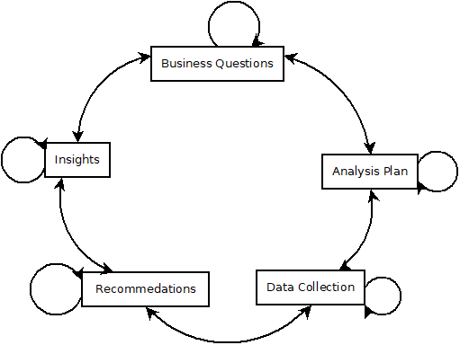
Process Flow
Diagram of analysis process
Find the real and actionable Business question | Formulate a hypothesis-driven Analysis plan | Collect relevant Data based on the Analysis Plan | Derive Insights using machine learning & statistics | Drive KPI’s with actionable Recommendation

Slide 7
Data Management
Data security during course of project
You customer data is protected by:
Username and password protection on the data analyst’s laptop, which is also protected through hard drive encryption software
All customer data will be removed from the company hardware upon project analysis completion
In adherence with any additional requirements based on your own internal data security and handling compliance requirements

Slide 8
Data Sources
Summary of Data
For this project, we will:
Have access to an historical data set representative of CreditOne clients which includes demographic, balance limits, and payment activity over time.
Data for project analysis will be provided by FTP, email, or other internally/externally protected/encrypted processes in compliance with all in internal procedures.
Data for analysis is presumed to be primary contained in the file: “default of credit card clients.csv”

Slide 9
Data Summary
Description and location of project data
Data included for analysis:
30,000 client accounts with complete (no missing) attribute values for each record (April to September 2005)
Each observation includes the balance limit and demographics about the borrower
Balance Limit – the amount that can be borrowed; currently approved limit to borrow for the account
Sex – gender of borrower
Education – education level of borrower
Marriage – marital status of borrower
Age – age of the borrower
Payment details (April to September, 2005)
A history of past payment status – no consumption, paid in full, or number of months delayed payment
A history of monthly balances at statement time – amount in dollars each month at statement billing period end
A history of monthly payments – total amount paid each month by borrower toward balance
A value for default/not default – 1/0 to indicate whether the account is in default or not

Slide 10
Known data issues
Issues and remediation plan
April – September 2005 provided
No observed issues with the data based on summary review
Note: data is 15 years old – it is possible more current data would provide a better representation of customer performance based on current market dynamics
Recommendation: provide a more current data set at some point for further analysis.

Slide 11
Data Summary
Statistical summary of analyzed data
Account Status Summary
Total Accounts: 30,000
Default Accounts: 6,636
Accounts in Good Standing: 23,364
Customer Demographics
Age: Min: 21, Max: 79, Mean: 35.49
Sex: M = 11,888, F = 18,112
Education:
Grad School: 10,585
University: 14,030
High School: 4,917
Other: 468
Marriage Status:
Married: 13,659
Single: 15,964
Divorced: 323
Other: 54

Slide 12
Recommendations
enhancements for measurement data
Updated data
Provide more current data for analysis that more accurately models current market/customer conditions
Expand Demographics
Include general geographic identifiers for customers to more accurately model current market/customer conditions by geography – different geographies tend to perform differently (i.e. Detroit versus Austin)
Include Profession
Different professions may have different payback profiles, possibly even by geography
Include general market data
Performance of the market overall and by geography might indicate customer performance

Slide 13

Questions

